Slide 1
MINI PROJECT SEMINAR
IOT BASED
SMART CONTAINER USING NODE - MCU
BATCH NUMBER : X-B
INTERNAL GUIDE & PROJECT COORDINATOR :
Prof . B . GIRI RAJU
N.NARESH - 20AG5A0419

Slide 2


CONTENTS
WHY THIS PROJECT ?
BLOCK DIAGARAM
CODE FLOW
ADVANTAGES
DISADVANTAGES
APPLICATIONS
CONCLUSION
REFERANCES
CIRCUIT DIAGARAM
PYSCIAL APPEARANCE

Slide 3


WHY THIS PROJECT ?
Now a days, In our day to day life, people became more busy such that they are much more immersed in their work schedule and are unable to concentrate or take care of their household things.
Most of the time people find it difficult to track their kitchen items, because nowadays it has become a room of least visit. In a scenario, where people find hard time to prepare their own food, it is even more difficult for them to track their grocery items in their room.
They even waste most of their time in ordering and tracking the remaining items in kitchen room
So, to rectify this problem & to make your kitchen look awesome, we introduced a " IOT Based Smart Container " . Which continuous tracks the items percentage filled in container and notifies to the user by mail

Slide 4
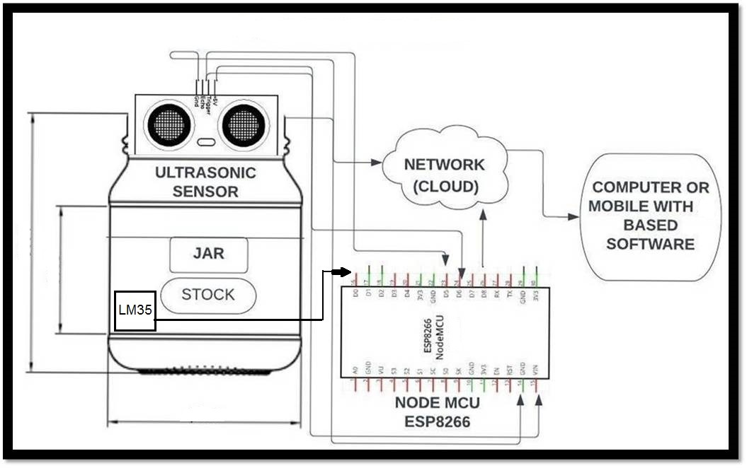
BLOCK DIAGARAM
BLOCK DIAGARAM
LM35

Slide 5
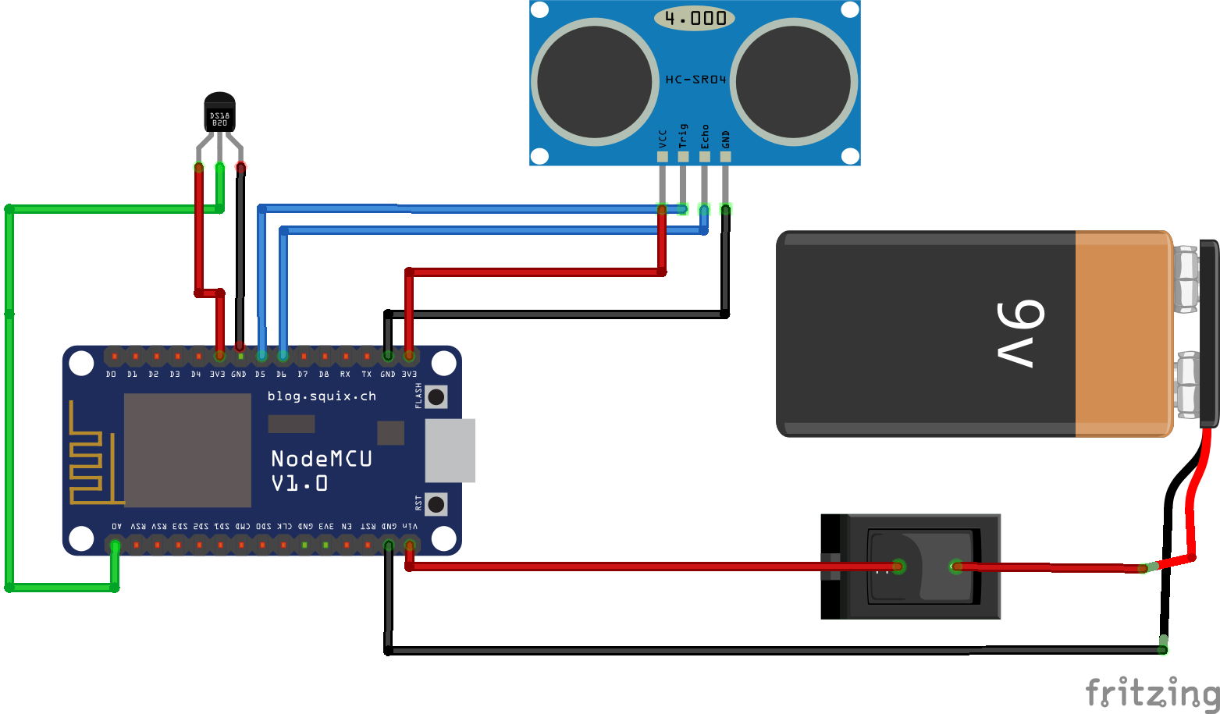
CIRCUIT DIAGRAM

Slide 6
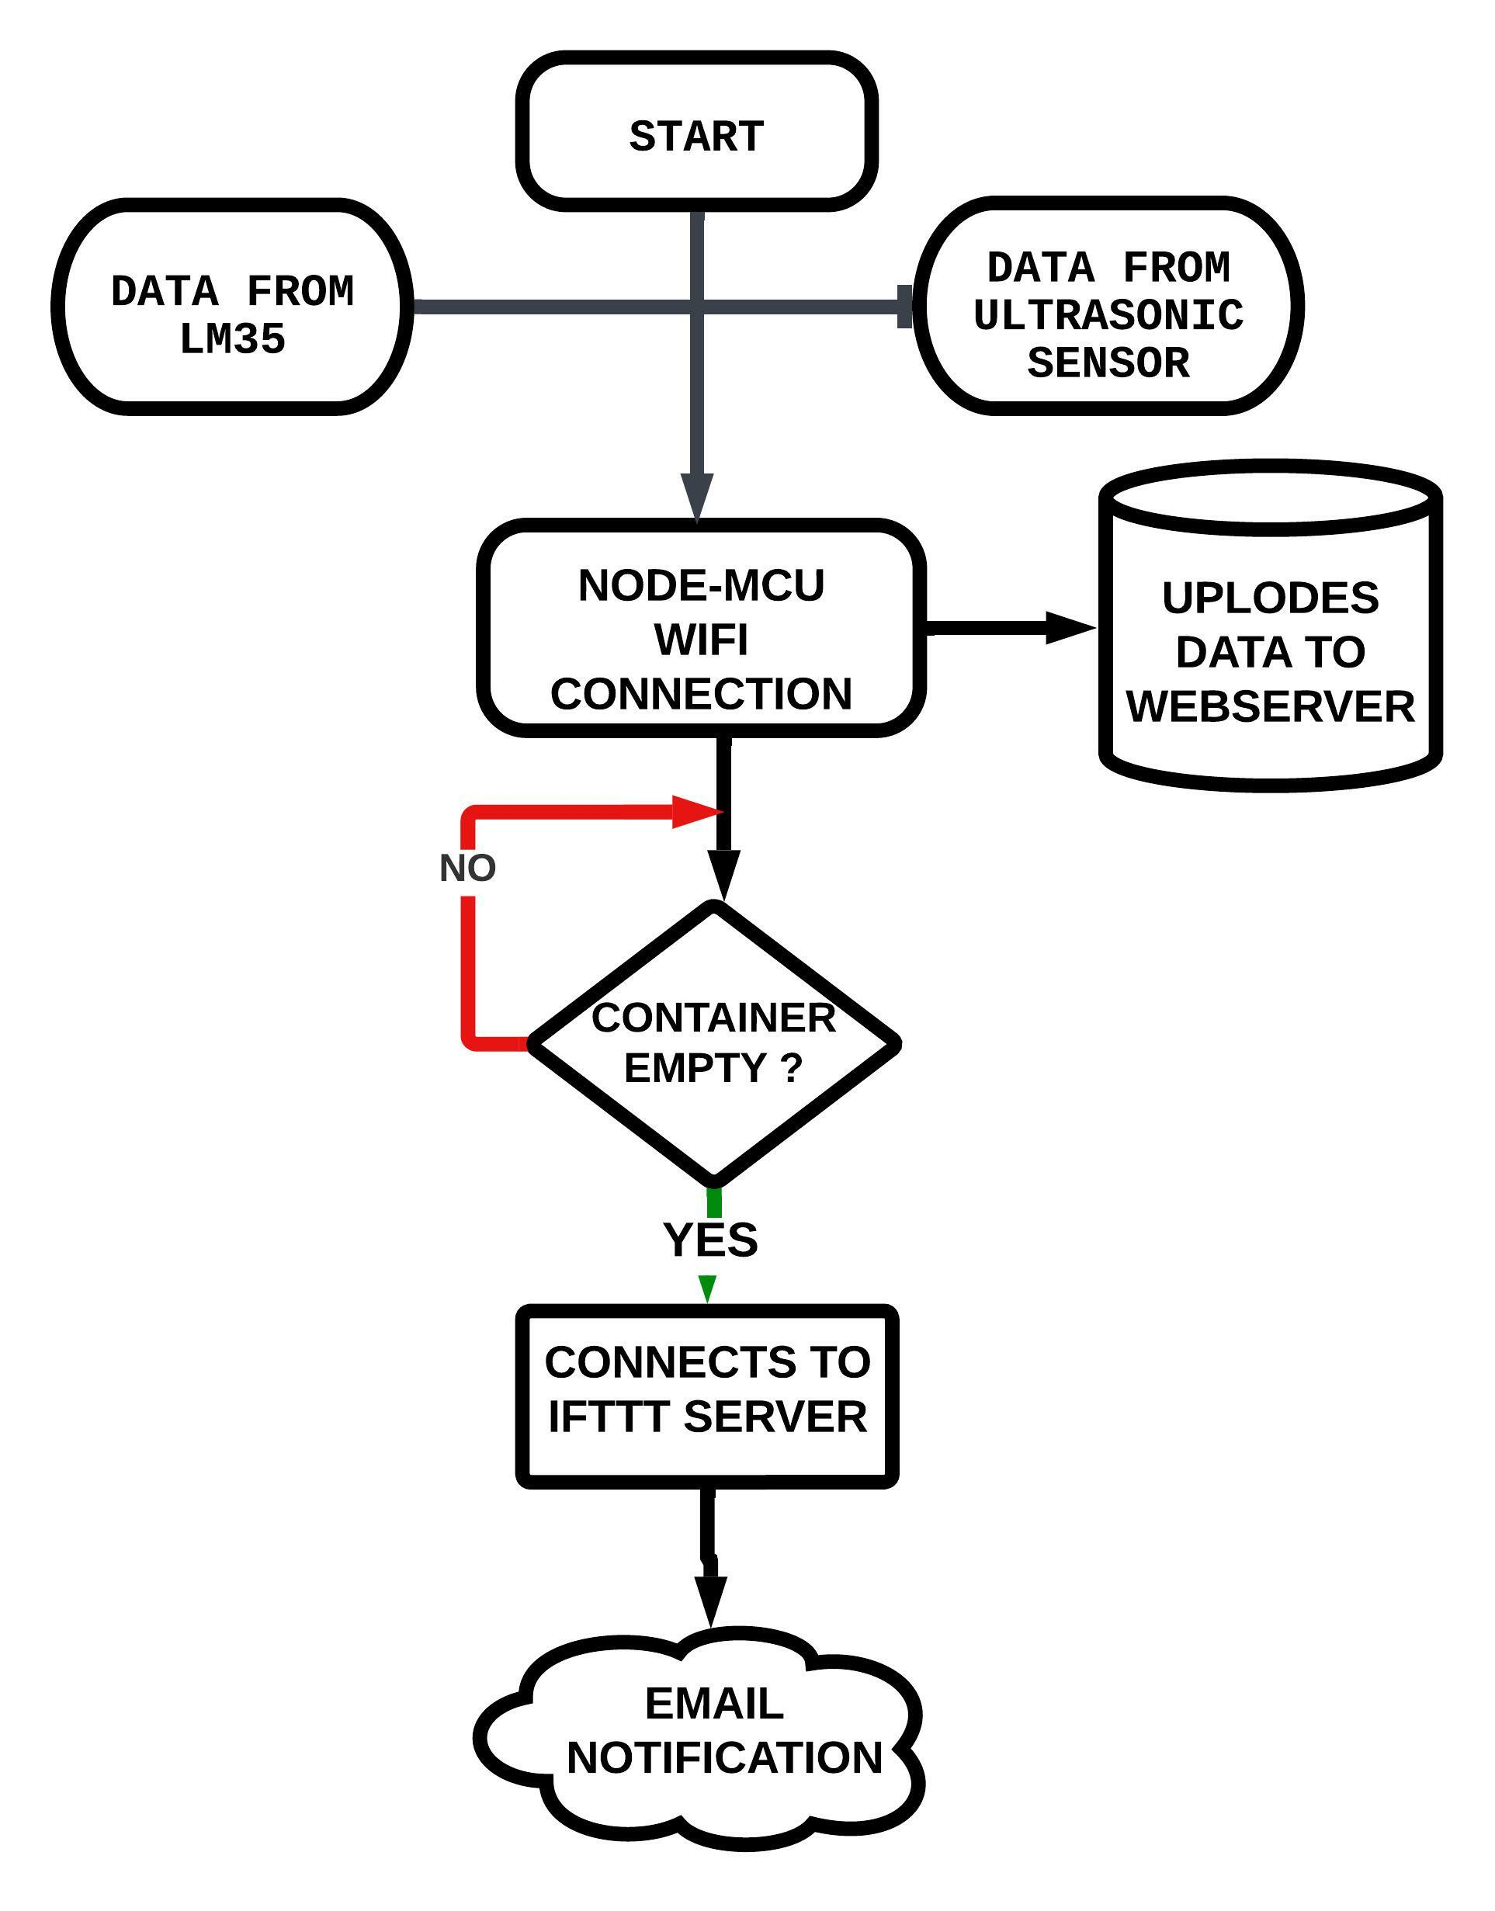
CODE FLOW
It starts from collecting data from Ultrasonic sensor and LM35 sensor
All the Data transfers to Node-MCU then it connects to wi-fi router.
From Wi-Fi the data will upload to Web Server.
Here is a decision maker by why which the output depends on level of the container filled i.e Ultrasonic Sensor value.
If the level is 0 % then it goes connect the IFTT server ,from there we get a email Notification .That your container is empty. Please refill it..
If the level is more than 10% the loop repeats again.

Slide 7
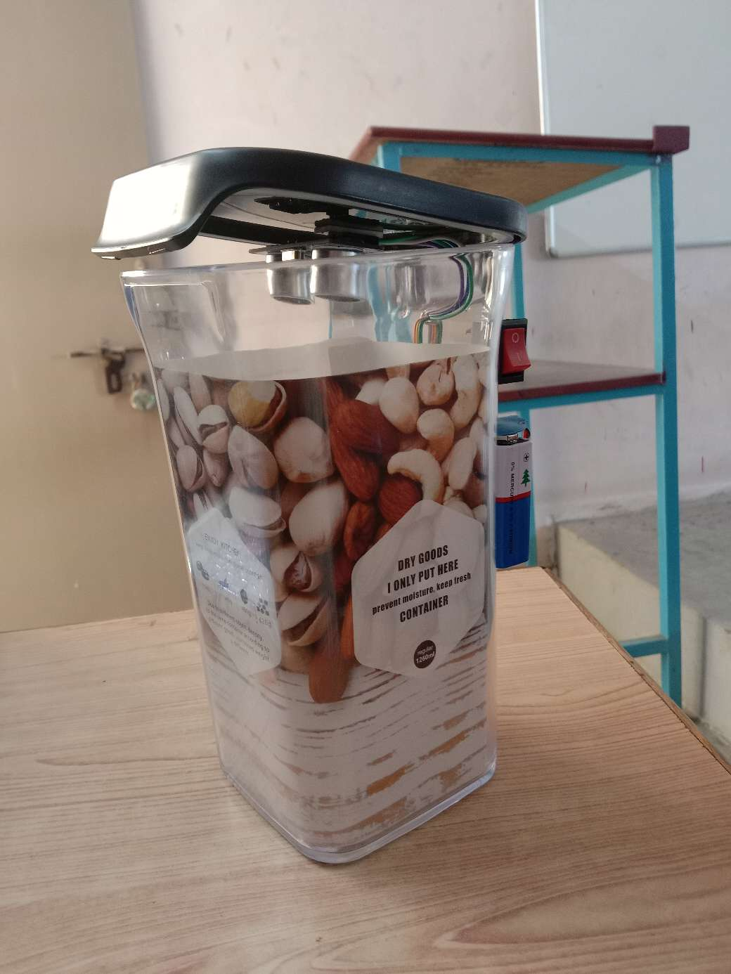
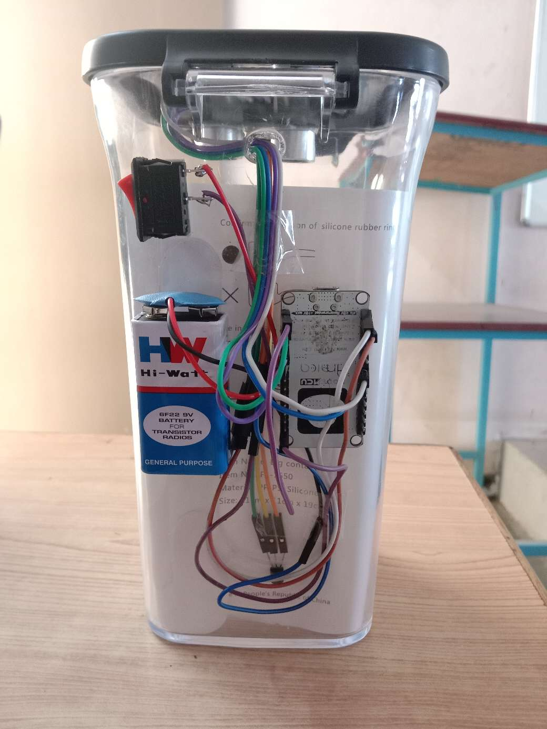
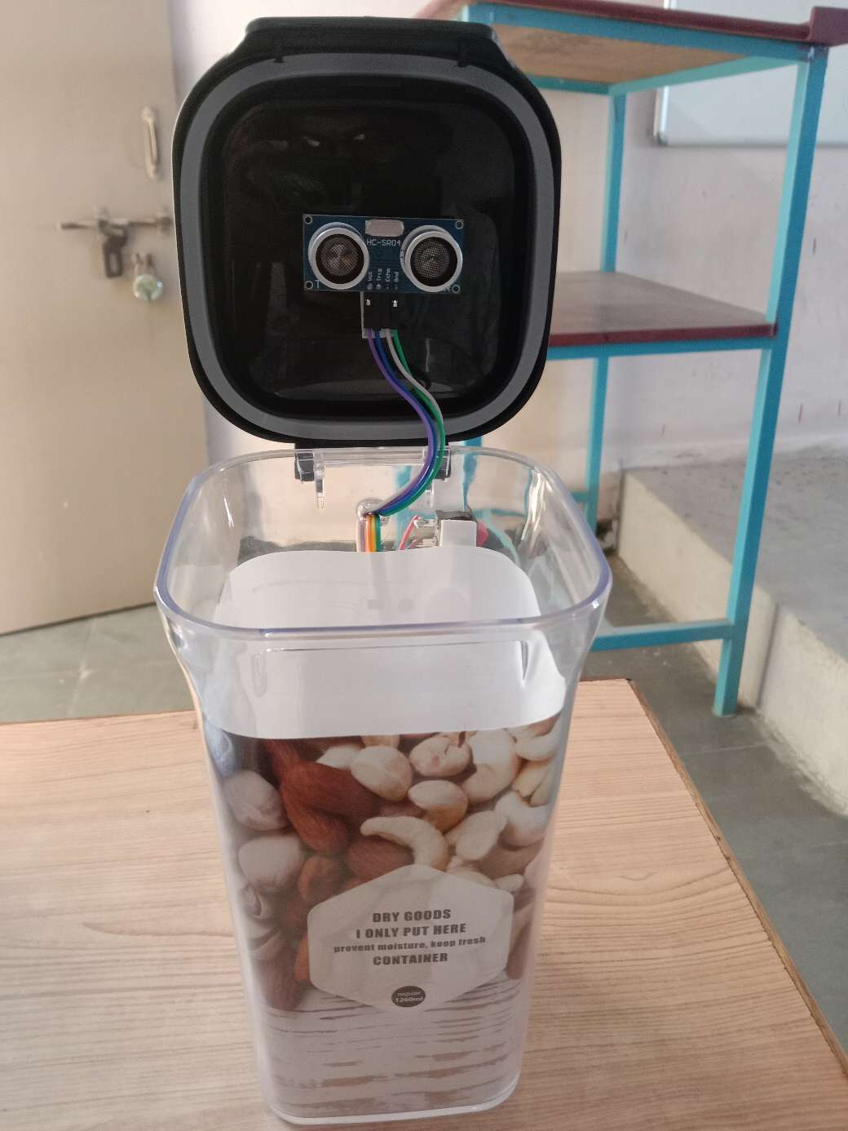
PHYSCIAL APPEARS OF PROJECT

Slide 8

components
HARDWARE REQUIRMENTS:
NodeMCU ESP8266 Wi-Fi Module
Ultrasonic Sensor HC-05
LM35 Temperature sensor
Switch
9V Battery
Jumper wires
Container
SOFTWARE REQUIREMENTS :
Arduino IDE
IFTTT

Slide 9
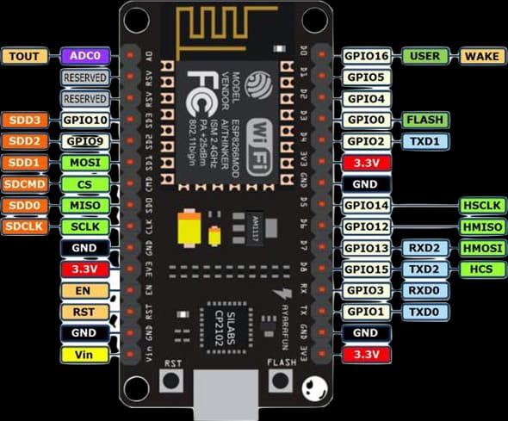
NODEMCU ESP8266 WI-FI MODULE
The NodeMCU ESP8266 development board consists of microprocessor that supports RTOS and operates between 80 MHz and 160MHz range clock frequency.
It has 128 KB RAM to store the programmable data memory. It has inbuilt deep sleep operating feature hence makes it convenient to use for wide range IOT projects.
It can be powered using MicroUSB pin or External power supply pin. The NodeMCU is programmed using Arduino IDE.

Slide 10
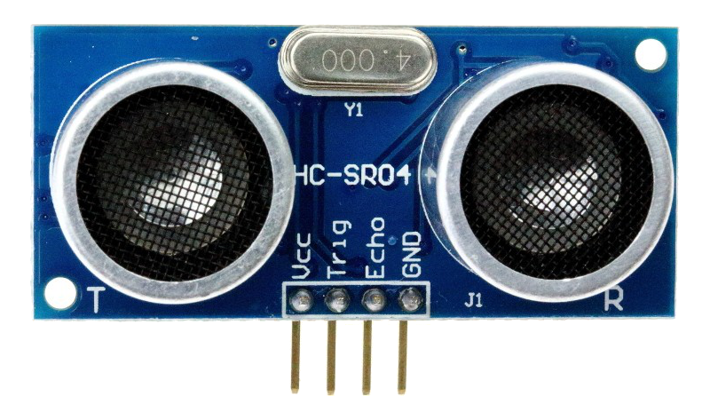
ULTRASONIC SENSOR
An ultrasonic sensor is a device that transmits and receives ultrasonic waves and converts them into electrical signals.
It is mainly used to tell how far away is the object. The ultrasonic sensor has basically two parts: one is transmitter and the other is receiver.
The transmitter emits the ultrasonic waves towards the targeted object. The waves hit the target object and return towards the sensor within a specific time.
The receiver of the ultrasonic sensor receives these reflected waves. The sensor calculates the time taken between the transmission and receiving of the signal waves.
The distance is calculated by the formula distance=time*(speed of the wave).

Slide 11
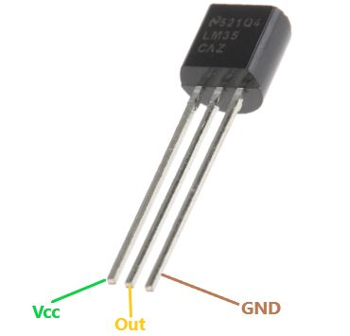
LM35 TEMPERATURE SENSOR
LM35 is a three-terminal linear temperature sensor from National semiconductors.
output voltage varies according to the temperature around it.
The temperature it can measure should be anywhere between -55°C to 150°C.
It provides an output voltage in Centigrade (Celsius)
The accuracy level is very high if operated at optimal temperature and humidity levels.

Slide 12
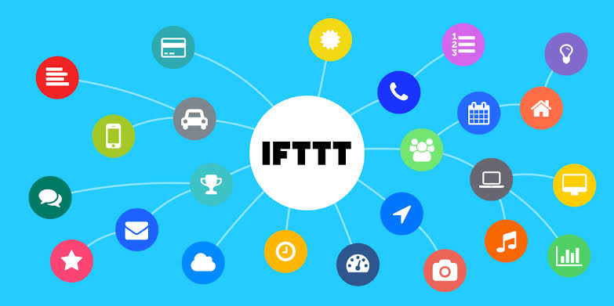
IF THIS THEN THAT(IFTTT)
IFTTT allows you to do more with over 700 different apps and services, including Twitter, Dropbox, Evernote, Fitbit, Amazon Alexa, and Google Assistant.
On IFTTT, we call these services. A list of all services on IFTTT can be found here
We bring services together into Applets, automations that allow you to do things your apps and devices can't do on their own.
IFTTT is short for 'If This Then That', and is pronounced like 'Gift' without the 'G'.
We used to be called 'if this, then that' because Applets would have one trigger and one action. If this happens — then that happens.

Slide 13

ADVANTAGES
We tract the percentage of filled amount in container without presence of him/her.
With the help of Web server we can accessible anywhere any time
It consumes less space for circuit connection.
As major components are 2 , so power consumption also less.
By the Smart jar the house will be more modern smart house.
It adds a comfort to the people who work long distance from home.

Slide 14


DISADVANTAGES
All the time it need an internet connection.
A continuous power supply is required.

Slide 15
APPLICATIONS
The smart container can be used to track the amount of contents of the container from anywhere.
It is mostly useful for those who find difficult to know the amount of conents
It is useful for the busy schedule persons.
It can be also used in general stores.

Slide 16
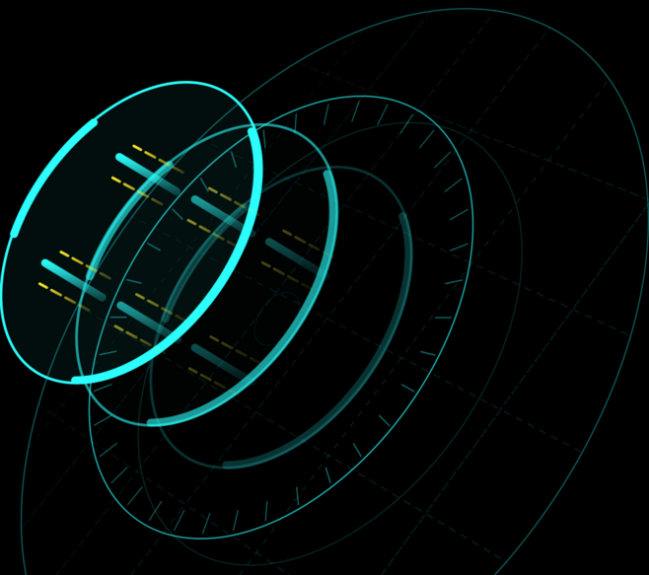
FUTURE SCOPE
The container can be developed for multi-purpose usage such as measuring the liquid quantity of some chemical solutions in a container.
In manufacturing industries, where the material is feed from containers

Slide 17

References
Circuit Digest for LM35 sensor https://circuitdigest.com/microcontroller-projects/iot-digital-thermometer-using-nodemcu-esp12-and-lm35
Circuit Digest for Node-MCU
https://circuitdigest.com/microcontroller-projects/iot-based-smart-jar-using-nodemcu-esp8266-
and-ultrasonic-sensor
Electronic Clinic for programming https://www.electroniclinic.com/nodemcu-esp8266-web-browser-programming-and-circuit-diagram
https://docs.arduino.cc/tutorials/

